Slide 1
FORM FDA 3454 (Certification)
Presented By: Vinay, Digvijay, Aarti, Manasi, Dr.Geetu

Slide 2
Content
About 21 CFR Part 54
Introduction to form 3454
Purpose
Summary of Financial Reporting Requirements for Clinical Investigators (Flowchart)
Form FDA 3454- Key Definitions
References

Slide 3
21 CFR Part 54
It is a financial disclosure by clinical investigators.
For the purpose of this part :-
Compensation affected by the outcome of clinical studies – 54.2(a)
Significant equity interest in the sponsor of a covered study – 54.2(b)
Proprietary interest in the tested product – 54.2(c)
Clinical investigator – 54.2(d)
Covered clinical study – 54.2(e)
Significant payments of other sorts – 54.2(f)
Applicant – 54.2(g)
Sponsor of the covered clinical study – 54.2(h)

Slide 4
Introduction (1/2)
Form 3454 or The Financial Certification or Disclosure Statement is used to submit information regarding clinical investigators who participated in the clinical studies.
Form 3454 contains in the 21 CFR Part 54
Applicable since 1999
The Financial Disclosure by Clinical Investigators regulation (21 CFR part 54) requires applicants who submit a marketing application for a drug, biological product or device to submit certain information concerning the compensation to, and financial interests and arrangements of, any clinical investigator conducting clinical studies covered by the regulation.

Slide 5
Introduction (2/2)
FORM FDA 3454, Certification, for any clinical investigator who has no disclosable financial interests in or arrangements with any sponsor of the covered clinical study.

Slide 6
Purpose
FDA evaluates clinical studies submitted in marketing applications, required by law, for new human drugs and biological products and marketing applications and reclassification petitions for medical devices.
FDA may consider clinical studies inadequate & data inadequate if steps have not been taken to minimize bias.
“Potential source of bias in clinical studies is a financial interest of the clinical investigator in the outcome of the study”
Notes:
Potential source of bias in clinical studies is a financial interest of the clinical investigator in the outcome of the study:
For instance: way payment is arranged (e.g., a royalty) or because the investigator has a proprietary interest in the product (e.g., a patent) or because the investigator has an equity interest in the sponsor of the covered study.

Slide 7
Financial reporting requirements apply to CI, Sub-I, their Spouses & Children
OR
Certify that no financial interest or arrangements exist
Disclose financial interests & arrangements and describe steps to minimize bias
Summary of Financial Reporting Requirements for Clinical Investigators (Flowchart)
Form FDA 3454, Certification of Financial Interests
Form FDA 3455, Disclosure of Financial Interests
OR
Any marketing application for a drug, biological product or medical device that relies in part on clinical data

Slide 8
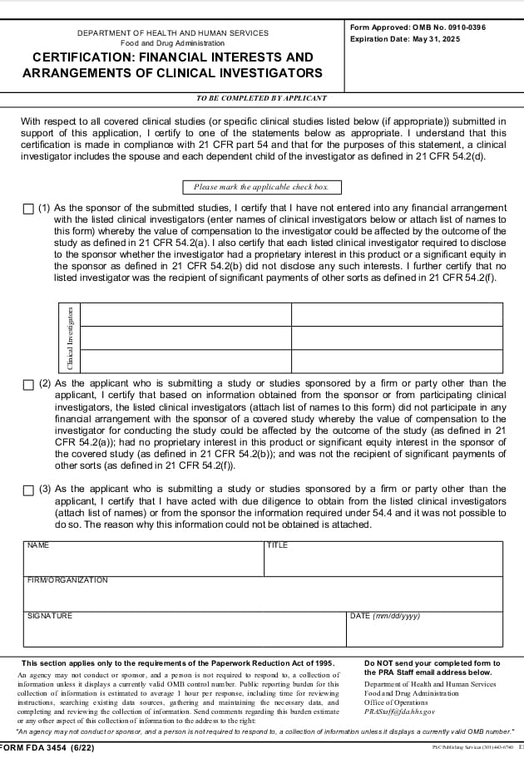
Form FDA 3454 (Certification)

Slide 9
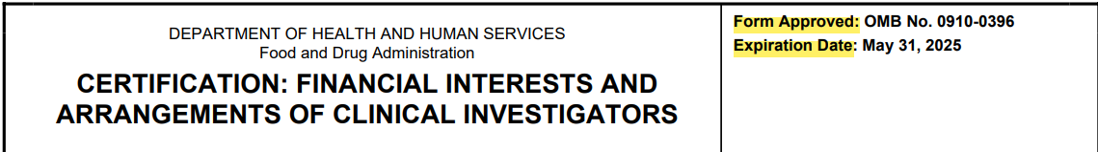
Form 3454 (1/10)
Certification : Financial Interests & Arrangements of Clinical Investigators
Form approved: OMB No.
Expiration Date

Slide 10
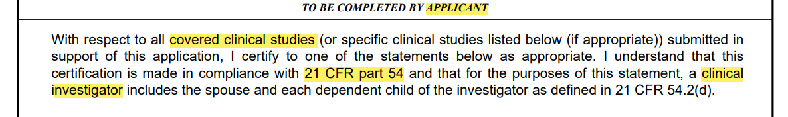
Form 3454 (2/10)
Covered clinical study: Means any study of a drug or device in humans submitted in a marketing application.
Clinical Investigator: Means a listed or identified investigator or sub-investigator who is directly involved in the treatment or evaluation of research subjects.
Applicant: Means the party who submits a marketing application to FDA for approval of a drug, device or biologic product.

Slide 11
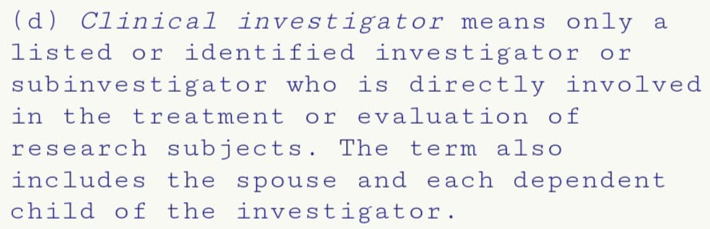
Form 3454 (3/10)
21 CFR 54.2(d) - Clinical investigator

Slide 12
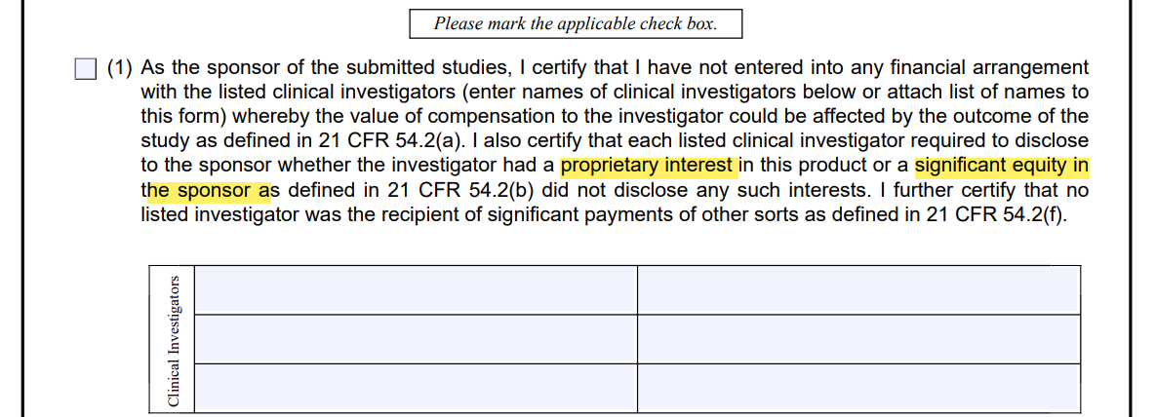
Form 3454 (4/10)
Proprietary interest: Means, a patent, trademark, copyright or licensing agreement.
Significant equity interest in the sponsor of a covered study means any ownership interest, stock options
Notes:
Compensation affected by the outcome of clinical studies means compensation that could be higher for a favorable outcome than for an unfavorable outcome

Slide 13
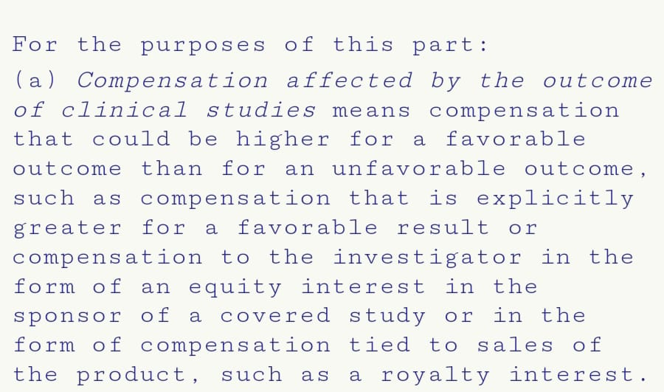
Form 3454 (5/10)
21 CFR 54.2(a) - Compensation affected by the outcome of clinical studies

Slide 14
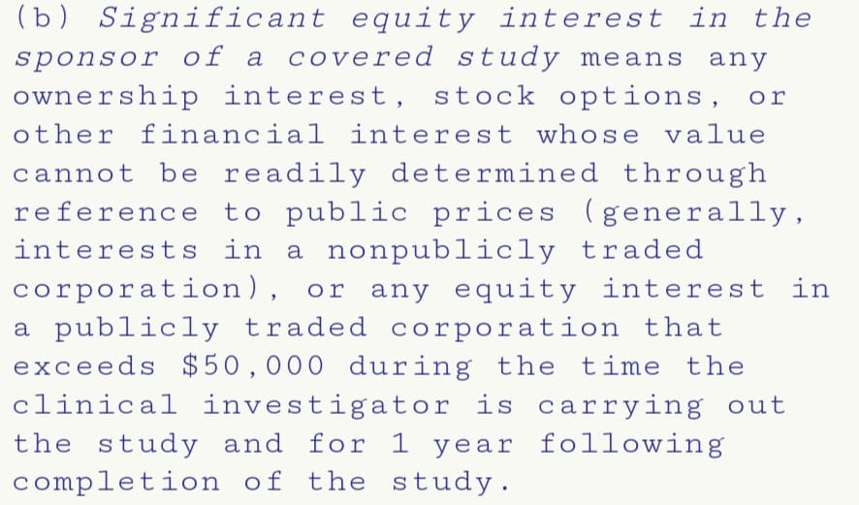
Form 3454 (6/10)
21 CFR 54.2(b) - Significant equity interest in the sponsor of a covered study

Slide 15
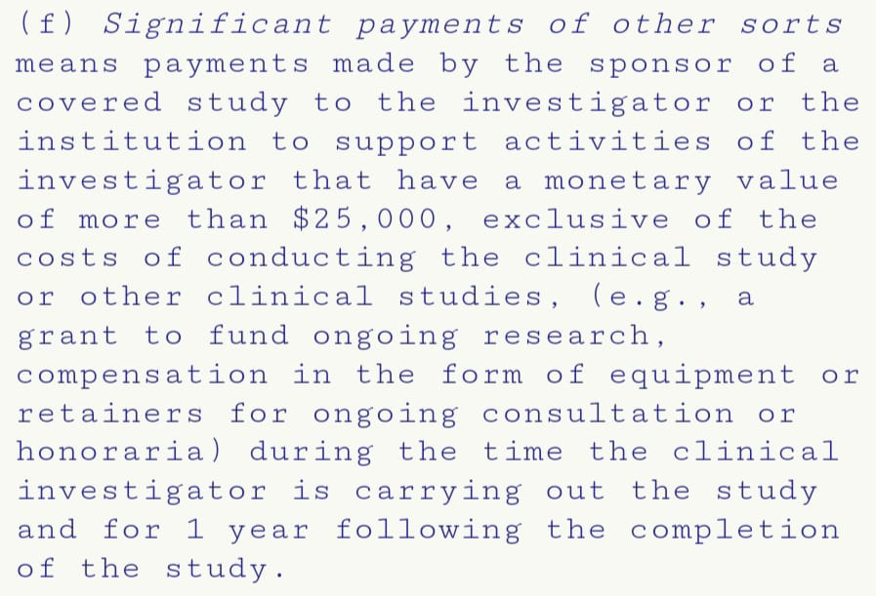
Form 3454 (7/10)
21 CFR 54.2(f) - Significant payments of other sorts

Slide 16
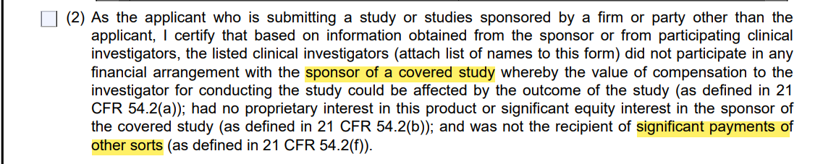
Form 3454 (8/10)
Sponsor of the covered clinical study: Means a party supporting a particular study at the time it was carried out.
Significant payments of other sorts (SPOOS): Are payments that have a cumulative monetary value of $25,000 or more and are made by any sponsor of a covered study to the investigator or the investigator’s institution during the time the clinical investigator is carrying out the study and for one year following completion of the study.

Slide 17
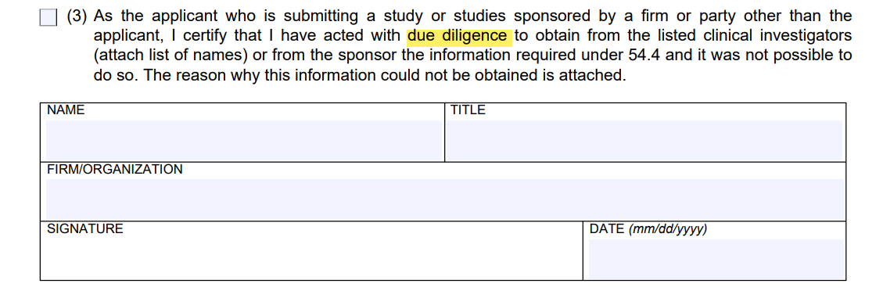
Form 3454 (9/10)
Due diligence: Is a measure of activity expected from a reasonable and prudent person under a particular circumstance, in this case, collecting information about financial interests or arrangements.

Slide 18
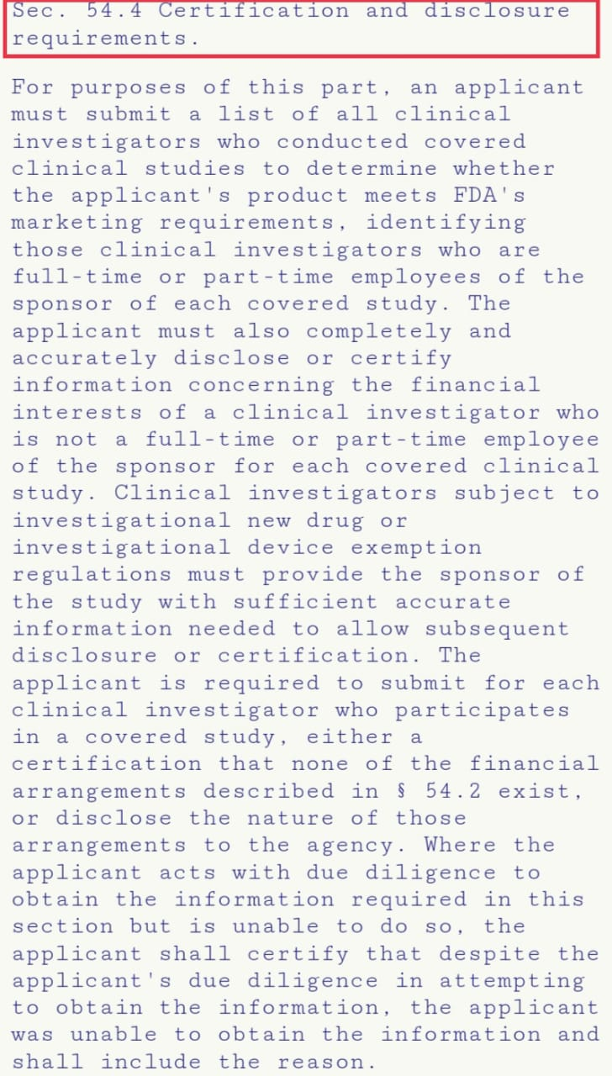
Form 3454 (10/10)
21 CFR 54.4

Slide 19
References
https://www.fda.gov/media/70465/download

Slide 20
Thank You

